Slide 1
Chapter 11:
The structure of the reproductive systems allows reproduction

Slide 2
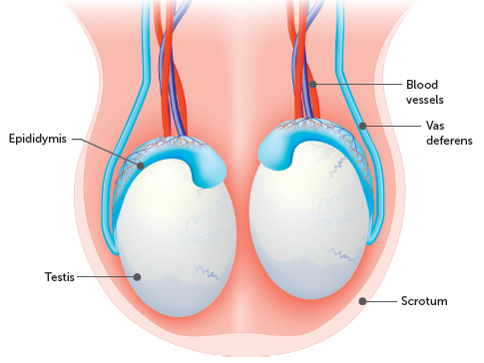
11.1 Structure of the reproductive systems
Male reproductive system
The male gonads consist of two testicles or testes, where the male gametes, spermatozoa (or sperm), are produced. The testes are held and supported in a skin-covered pouch called the scrotum. The scrotum is divided internally into two sacs, each containing a single testis.
The production and development of sperm requires a temperature that is about 2°C lower than the normal body temperature. Therefore, the testes lie in the scrotum, outside the body cavity. Muscle fibres in the wall of the scrotum contract and relax to move the testes closer or further away from the body to regulate temperature.

Slide 3
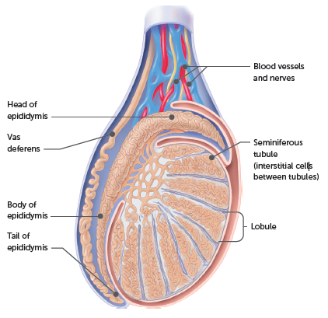
11.1 Structure of the reproductive systems
Each testis is divided into lobules, filled with seminiferous tubules. These tubules are lined with cells that produce the male gametes. They eventually join into ducts, which leave the testis and enter the epididymis. Between the seminiferous tubules are clusters of interstitial cells.
The epididymis is a highly folded tubule that fits against the rear surface of each testis. Sperm from the testis enter the tubule of the epididymis where they are stored for up to a month while they mature.
Cross-section through a testis and epididymis, showing the system of tubules

Slide 4
11.1 Structure of the reproductive systems
The tubule of the epididymis continues to become the vas deferens (or sperm duct), which carries the sperm away from the testis. The vas deferens extends upwards from the testis, passes into the abdominal cavity and crosses the upper surface of the bladder. It then turns downwards, looping behind the bladder.
Under the bladder, the two vasa deferentia, one from each testis, join the urethra, which runs from the bladder, through the penis to the exterior. The urethra is a duct for transporting both urine and sperm.
Sperm is transported in semen, which is a mixture of secretions from three glands – the seminal vesicles, the prostate gland and the bulbourethral gland.
The urethra carries sperm and semen through the penis to the opening at the tip. In reproduction, the penis is used to transfer sperm from the male to the vagina of the female.

Slide 5
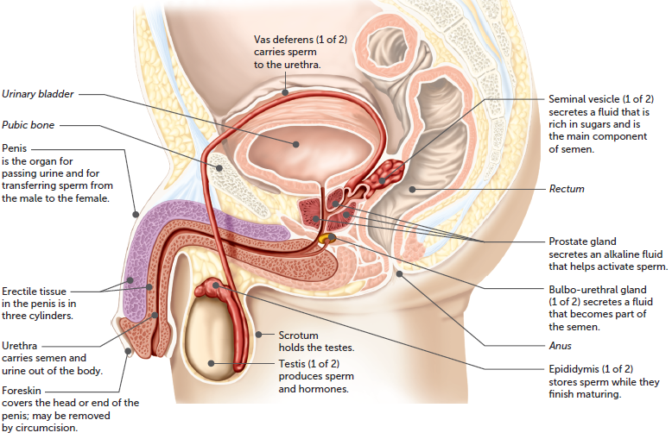
11.1 Structure of the reproductive systems
The male reproductive system. Structures indicated in italics are not part of the reproductive system

Slide 6
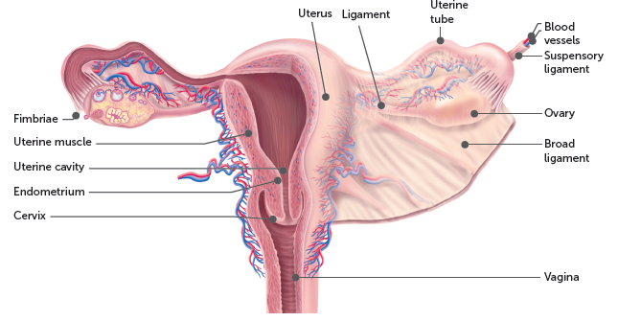
11.1 Structure of the reproductive systems
Female reproductive system
The two ovaries are the primary sexual organs, or gonads, of females. The ovaries produce the female gametes, the ova (or eggs). Each ovary is an almond-shaped gland approximately 3 cm in length, and are located completely within the body, one on each side of the abdominal cavity supported by ligaments.
Front view of the female reproductive system; the left side is cut away to show the internal structures

Slide 7
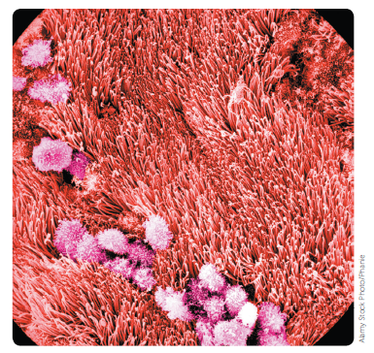
11.1 Structure of the reproductive systems
Each ovary is composed of a mass of connective tissue called the stroma. This is surrounded by a layer of cells containing numerous germ cells. Each germ cell is enclosed in a follicle; at any one time there are numerous follicles in various stages of development. As a follicle matures, it moves to the surface of the ovary and ruptures. The egg is expelled into the funnel-like opening of the uterine tube. There are two uterine tubes (also called Fallopian tubes, or oviducts), one extending from each ovary. They carry the egg from an ovary to the uterus.
The funnel-like opening near the ovary is fringed with finger-like projections that appear to just touch the surface of the ovary. These projections, called fimbriae, help to guide the egg into the uterine tube. The lining of the tube contains cilia whose movement carries the egg towards the uterus. Contraction of smooth muscles in the wall of the uterine tube also aids this movement of the egg.
TEM of cilia at the surface of the oviduct

Slide 8
11.1 Structure of the reproductive systems
The uterus (or womb) is situated behind the urinary bladder and in front of the rectum. The wall of the uterus is made up mainly of smooth muscle, with a soft mucous membrane lining called the endometrium.
At the lower end of the uterus is the cervix, or neck of the uterus. The cervix protrudes into the vagina, a canal leading to the outside of the body. The vagina receives the penis of the male during sexual intercourse and enlarges to form the birth canal during childbirth.
The vagina opens to the exterior in a region termed the vulva, which is made up of the external genital organs of the female – the labia majora, the labia minora and the clitoris.

Slide 9
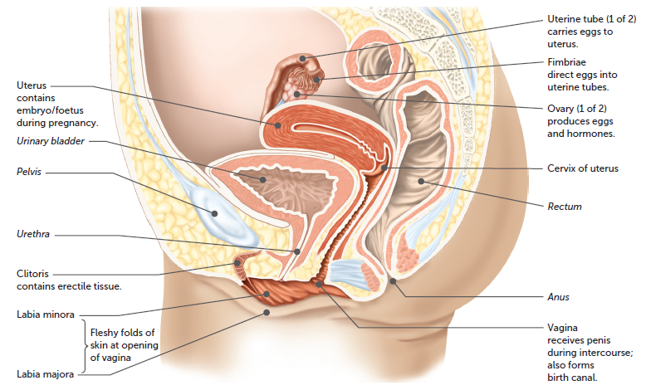
11.1 Structure of the reproductive systems
The female reproductive system. Structures indicated in italics are not part of the reproductive system

Slide 10
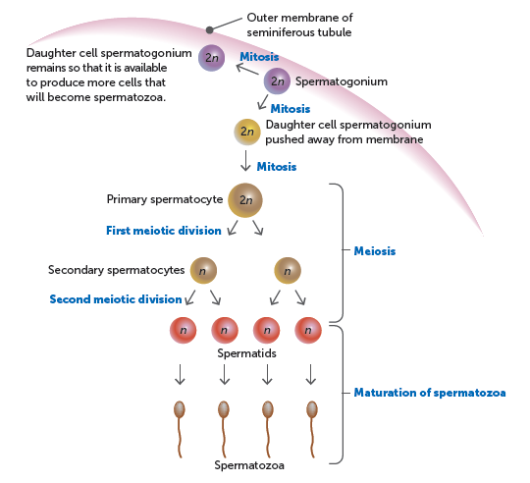
11.2 Production of gametes
Gamete development, from meiosis to mature gametes, is called gametogenesis. There are two types of gametogenesis: formation of spermatozoa in the testis is called spermatogenesis and formation of ova in the ovary is called oogenesis.
Production of sperm
Spermatogenesis occurs inside the seminiferous tubules of each testis, and results in four spermatozoa from each spermatogonium. The process takes ~72 days and occurs continuously after puberty.
Process of spermatogenesis

Slide 11
11.2 Production of gametes
Sperm is made up of a head, neck, middle and tail:
The head consists almost entirely of the nuclear material, with a fluid-filled vesicle at its tip, called the acrosome. In the fluid are enzymes, which break down the layer of cells surrounding the egg so that fertilisation can occur.
The neck lies between the head and the middle piece.
The middle piece contains mitochondria, where respiration takes place to provide the sperm with energy for movement. Around the mitochondria is a thin layer of cytoplasm. Because there is so little cytoplasm, sperm have a short survival period and receive their nourishment from the semen in which they are suspended.
The tail is capable of contractile motions to propel the cell forward.

Slide 12
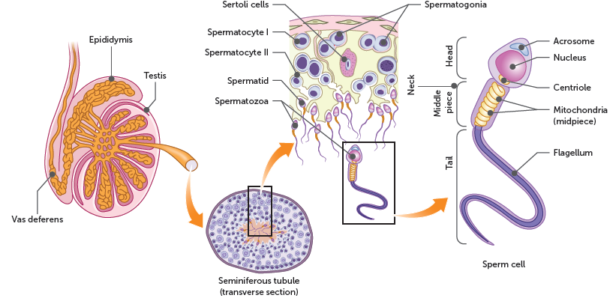
11.2 Production of gametes
Section of testis, showing spermatogenesis within a seminiferous tubule

Slide 13
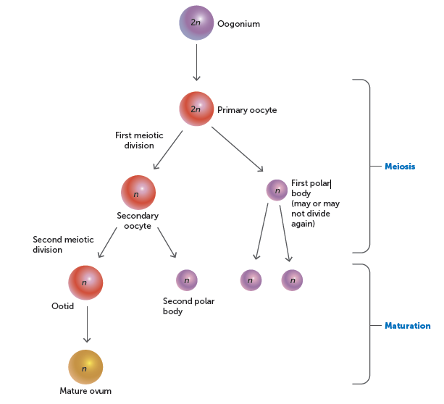
11.2 Production of gametes
Production of ova
Oogenesis occurs in the ovaries. Oogonia form primary oocytes prior to birth. After puberty, each primary oocyte completes its development to form a secondary oocyte and up to three polar bodies. The secondary oocyte is released during ovulation and completes meiosis if it is fertilised.
Process of oogenesis

Slide 14
11.3 Hormonal control of the reproductive system
Reproductive hormones
The pituitary gland is an important endocrine gland associated with the reproductive system. It is a small organ lying in a pit in the bone below the brain and above the roof of the mouth. Two hormones secreted by the pituitary affect the gonads, called gonadotropic hormones, or gonadotropins.
Follicle-stimulating hormone (FSH) stimulates the development and maturation of the ovarian follicle in females. During its development, the ovarian follicle secretes oestrogen. Secretion of FSH is reduced as the level of oestrogen increases in the blood.
Luteinising hormone (LH) promotes the final maturation of the ovarian follicle, ovulation, and the formation of the corpus luteum. The corpus luteum secretes progesterone as well as oestrogens. There is a reduction in production of LH as the level of progesterone in the blood increases.
The pituitary gland also releases prolactin (important in the preparation and maintenance of milk production) and oxytocin (causes uterine contractions, amongst other effects).

Slide 15
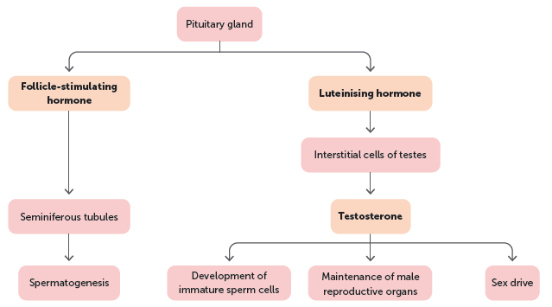
11.3 Hormonal control of the reproductive system
In males, the same gonadotropic hormones are secreted by the pituitary gland. FSH stimulates the epithelial tissue of the seminiferous tubules in the testes to produce sperm. LH stimulates cells in the testes to secrete the hormone testosterone, which is important for the development of immature sperm cells into mature spermatozoa.
At puberty, the secretion of gonadotropic hormones stimulates a number of physical and psychological changes in males and females. In males, the production of testosterone influences the development of the body to sexual maturity. In females, sexual maturation is brought about by oestrogens.

Slide 16
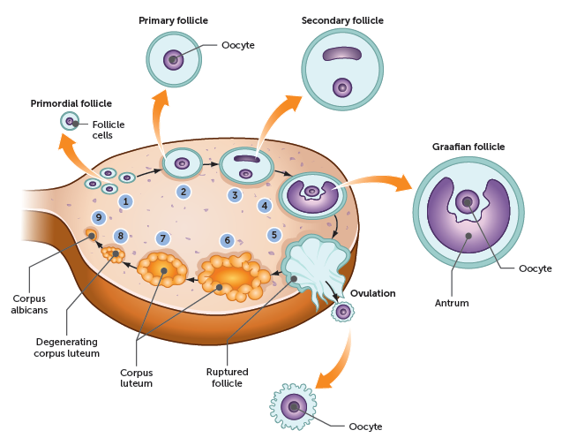
11.3 Hormonal control of the reproductive system
The ovarian cycle
The ovarian cycle is a series of events that take place within the ovaries. It includes the maturation of an egg and its release into a uterine tube. Associated with these events are the development of follicles in the ovary and the formation of a structure called the corpus luteum. The average length of the cycle is 28 days.

Slide 17
11.3 Hormonal control of the reproductive system
At ovulation, the mature follicle bursts and expels the oocyte, which is gradually swept down the uterine tube towards the uterus by the beating of cilia lining the inside of the tube.
Following ovulation the corpus luteum is formed, which secretes oestrogen and progesterone. Progesterone influences the development of the lining of the uterus, preparing it for implantation if fertilisation occurs. It also inhibits the release of FSH and LH which prevent other follicles developing. If fertilisation has not occurred, the corpus luteum reaches its maximum development about 8 to 10 days after ovulation and then begins to degenerate.
If fertilisation of an egg takes place and pregnancy follows, the corpus luteum continues to develop and the ovarian cycles cease. The corpus luteum is maintained by human chorionic gonadotropin (HCG), a hormone produced by the developing placenta in a pregnant woman.

Slide 18
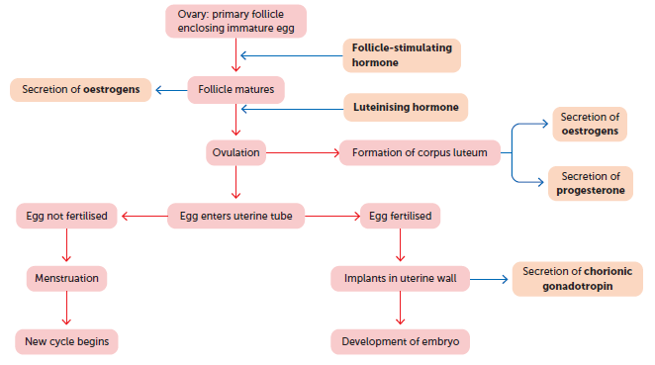
11.3 Hormonal control of the reproductive system
Summary of the relationship between the ovarian cycle and the reproductive hormones

Slide 19
11.3 Hormonal control of the reproductive system
The menstrual cycle
While the ovarian cycle is occurring, the uterus and vagina also go through a series of changes called the menstrual cycle. The changes in the uterine lining, the endometrium, are in preparation for a developing embryo in case the egg released at ovulation is fertilised.
In the first stage of the menstrual cycle, while the follicle is maturing in the ovarian cycle, progesterone causes the endometrium of the uterus to become thicker and softer. There is also an increase in the number of blood vessels and mucus-secreting glands. After ovulation the endometrium continues to thicken, and glands within it begin to secrete a watery mucus rich in glycogen.

Slide 20
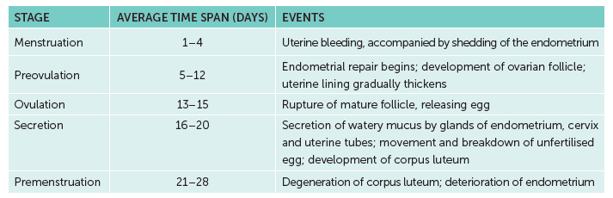
11.3 Hormonal control of the reproductive system
If the egg is not fertilised by a sperm, the corpus luteum degenerates, reducing the amount of progesterone, which results in its breakdown. About 14 days after ovulation, blood from broken-down capillaries, mucous secretions and cell debris from the uterine lining are lost through the vagina.
This is menstruation (often known as a ‘period’) and takes place over several days. As this event is the most recognisable point in the menstrual cycle, the onset of menstruation is taken to be day 1 of the cycle.
Major stages of the menstrual cycle

Slide 21
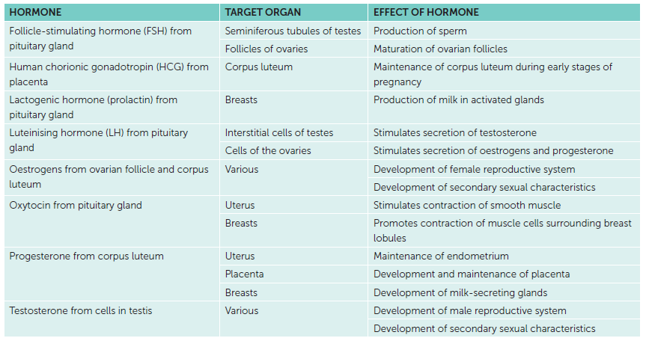
11.3 Hormonal control of the reproductive system
Summary of reproductive hormones

